Slide 1
SECURELY DELIVER DESKTOP APPLICATIONS ONLINE
Team members:
1.Gayethiri.R.S
2.Inba.M
3.Mary metilda.S
Industry Mentor
Faculty Guide:
Ms.
Department of CSE, KGiSL Institute of Technology, Coimbatore

Slide 2
Abstract This is mainly an Installation and configuration of applications on AppStream and stream the applications to the users. These applications are accessed through an HTML 5 browser. In this we can control the permissions who can access them.The administrative tasks can be performed in the AppStream console. To install applications using image builder. The optimization of applications can be using Image Assistant. The provision to an Amazon Virtual Private Cloud(VPC) using a provided AWS Cloud Formation Template. The VPC service will host the AppStream 2.0 resources within the isolated virtual network infrastructure.
Department of CSE, KGiSL Institute of Technology, Coimbatore

Slide 3
Area Introduction-Existing system
The desktop applications can be stored and it can be shared to the browser. This applications will be saved in the server. The assurance of secure usage of applications cannot be given in this system.
Department of CSE, KGiSL Institute of Technology, Coimbatore

Slide 4
Proposed System
Advantages over existing methods
scalability
Future Enhancements
The datas will be more securely shared to browser without any server problems or any other storing problems.
The shared applications,datas can be secured in VPC services and will be available 24/7.
Department of CSE, KGiSL Institute of Technology, Coimbatore

Slide 5
Literature Review
Drawbacks of existing methods
Server problems
Accessing applications through server
Department of CSE, KGiSL Institute of Technology, Coimbatore

Slide 6
Module Splitup
Module 1:
Creating Network Resources and appstream image builder
Module 2:
Connect to the image builder and install the app
Module 3:
create AppStream Image.
Module 4:
Provision a fleet and Appstream Stack and Manage Users.
Module 5:
Testing the User Experience and Streaming.
Department of CSE, KGiSL Institute of Technology, Coimbatore

Slide 7
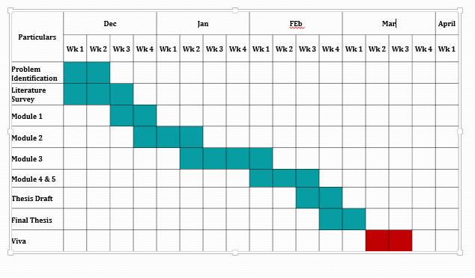
Project Planner / Timeline chart)
Department of CSE, KGiSL Institute of Technology, Coimbatore

